Slide 1



Basic Details of the Team and Problem Statement
Name of your Institute: YCCE
Team Name: Tensor
Problem Statement Code:SMA-005
Problem Statement Title: Platform to reduce food wastage

Slide 2
Description of Problem Statement :
Food waste is a significant global issue that affects both the environment and people in need. Many restaurants and grocery stores have surplus food that goes to waste, while people in the same communities often struggle with food insecurity which leads to economic losses of 92,000 crores rupees, and 7000 deaths in India.
The problem is caused due to ill Management of food supply. Needy can be fed just by connecting the producers to the consumers.
Objectives:
We propose to develop a platform ‘FoodBridge’ by connecting Grocers, Restaurants and Caterers with NGOs, organized groups and end consumers to reduce food wastage and to feed the needy.
Our platform is designed as a for-profit venture, ensuring sustainability while making a positive impact on reducing food waste and local job creation

Slide 3
Solution:
Grocery Stores, Retailers, Caterers can log into the platform and post about their surplus food/grocery products.
Notifications will be sent to NGOs, registered groups about the surplus food. They can either opt for pickup or delivery.
Individuals can order food online on the platform through the Swiggy/Zomato style UI.
Our delivery partner will perform checks for quality assurance to check whether the food is still consumable or not.
Adding review systems, and giving trust badges to the providers can help fortifying trust in the providers.
Grocery suppliers can list their products which are about to go stale on the platform on discounted price.

Slide 4
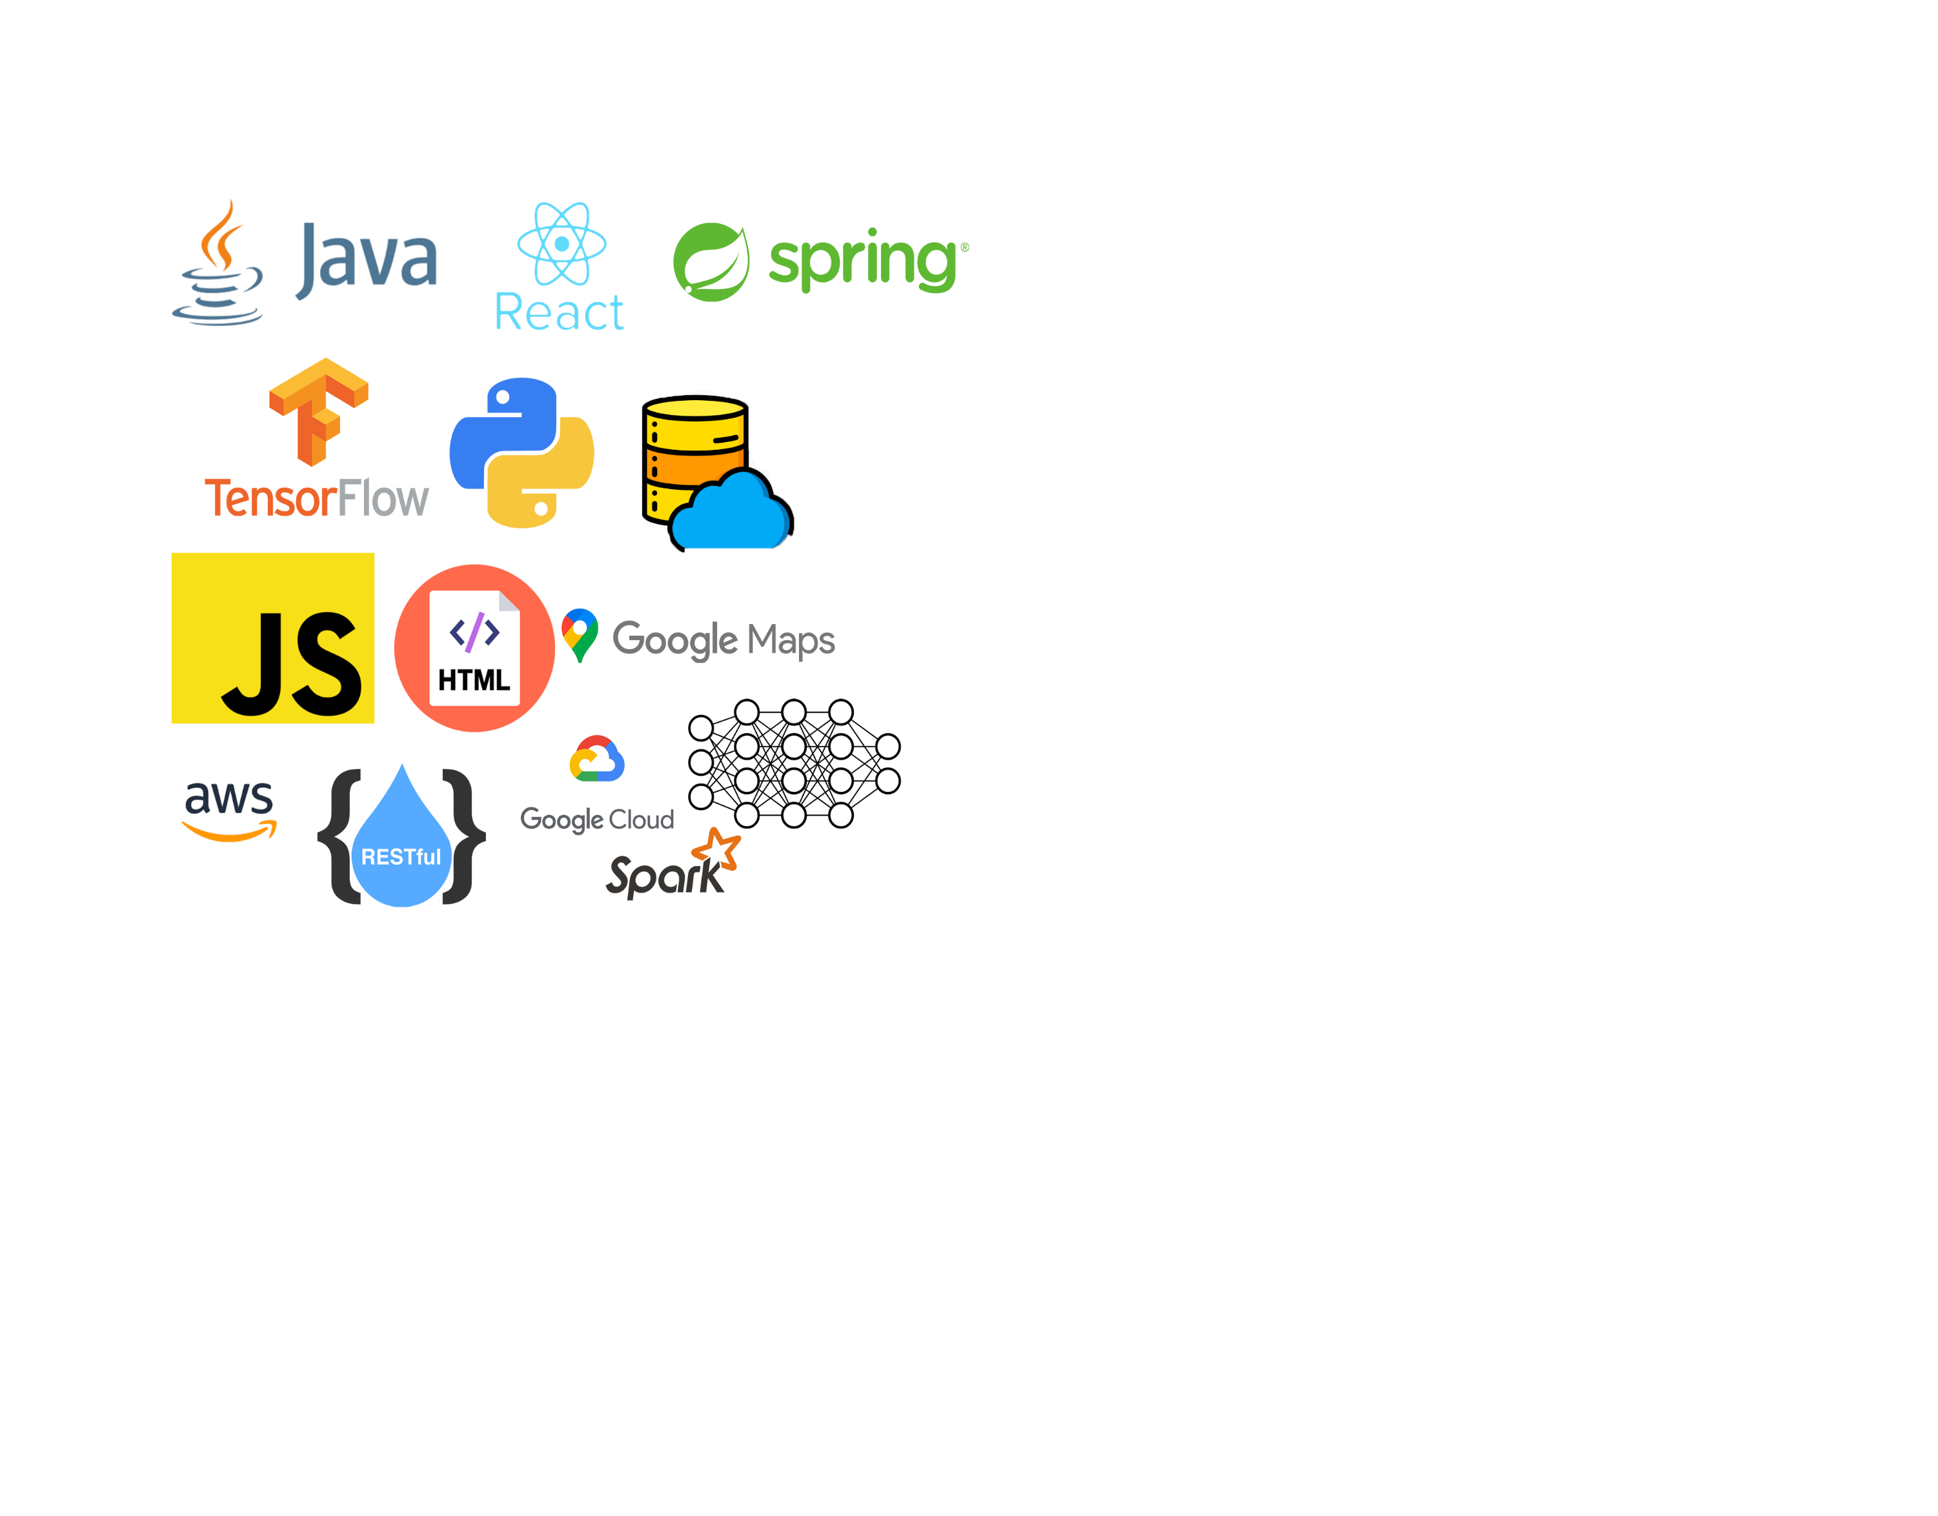
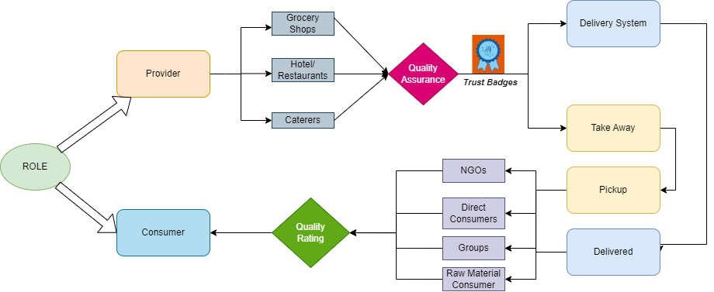
Idea Approach and Tackling:
TechStack:

Slide 5
Idea/Approach:
Creating Job Opportunities : ‘FoodBridge’ will employ delivery partners, creating job opportunities in the community.
Collaboration with NGOs and Restaurants : NGOs, restaurants, and cafes are key partners, subscribing to our app to provide food to a larger audience.
Trust Badges for Food Suppliers : Food suppliers will earn trust badges based on user reviews, enhancing their credibility.
Priority for Trusted Food Providers: Food providers with trust badges and higher ratings will be recommended to users, building trust and encouraging more customers.
Enhancing Brand Image : As users trust food providers, restaurants, cafes, and caterers earn a positive image, attracting more customers. These food providers will be recommended to users with the help of Machine Learning Algorithms.
Surplus Raw Material : Food providers can even provide surplus raw material to small vendors who can use it before the expiry.
Hotels will pay a commission for advertising, generating revenue.
Late-Night Food Service : ‘FoodBridge’ caters to the needs of hostel students, singles, and others seeking late-night food.
Late-night food orders are free (excluding delivery charges).

